Slide 1
Data Structures and Algorithms Project Presentation
Project title: AS DICTIONARY
Team Members:
Shehriyar Shariq (245009)
Ayesha Siddiqui (241615)
BSCS - 8A

Slide 2
Introduction
Console based dictionary for searching of English words with their respective meaning(s).
Uses Ternary Search Trees for keeping track of all words.
Has Undo/Redo functionality to switch between past searches.
Has a log of all the past searches.
Words stored as files.
Word base greater than 108,000 words

Slide 3
Problem Statement
In today’s digital era, using printed dictionaries to find meanings of words is very inefficient and time consuming.
Using online dictionaries requires the user to have an internet connection in order to search for the word.

Slide 4
Solution
Data Structures used
Ternary Search Trees
For searching words
more memory efficient than tries; uses 3 nodes instead of 26.
Stacks
To Undo and Redo word searches
Singly Linked Lists
For log panel
Dynamic size and easy insertion/deletion of nodes
HashTable
For storing of meanings

Slide 5
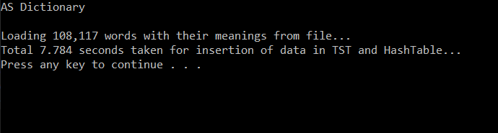
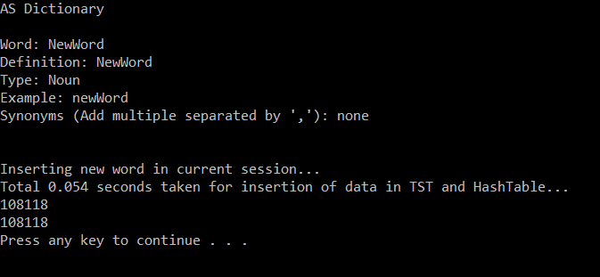
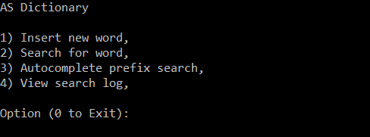
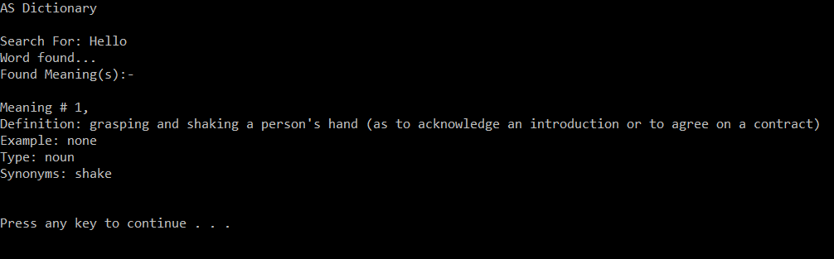
Screenshots

